Slide 1
Section 1.3: “Eulerizing” Graphs
Math for Liberal Studies

Slide 2
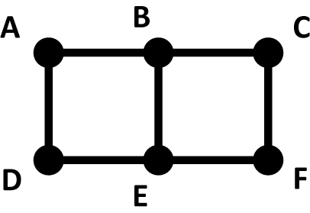
The Story So Far
Consider this graph
Does it have an Euler circuit?

Slide 3
The Story So Far
We count up the degree of each vertex, and find that B and E have degree 3
Since 3 is odd, this graph doesn’t have an Euler circuit

Slide 4
The Story So Far… Is It Over?
We know we can’t walk along all the edges in this graph without retracing our steps…
…if we accept that we have to retrace our steps, how do we minimize how much retracing we have to do?

Slide 5
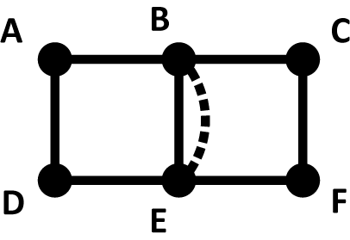
Modify the Graph
We will modify this graph by duplicating an existing edge: the edge from B to E
In this new graph, all the degrees are even, so we now have an Euler circuit

Slide 6
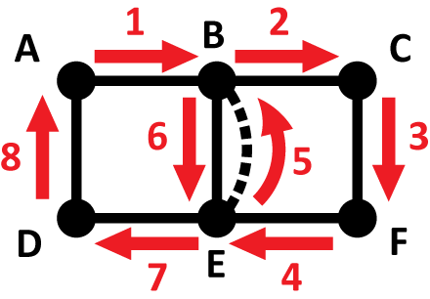
Find an Euler Circuit on the Modified Graph
This graph has many possible Euler circuits, including this one

Slide 7
What does this have to do with the original problem?
We have found an Euler circuit, but it’s not an Euler circuit for the original graph

Slide 8
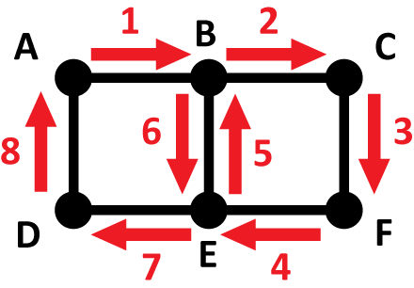
What does this have to do with the original problem?
If we take the Euler circuit from the modified graph and follow the same path on the original graph, this gives us a circuit with only one retrace

Slide 9
“Eulerizing” Graphs
If a graph doesn’t have an Euler circuit, we can “Eulerize” it by duplicating existing edges until all degrees are even
Find an Euler circuit on the modified graph
The same path on the original graph is a circuit that retraces the same edges that you duplicated in Step 1

Slide 10
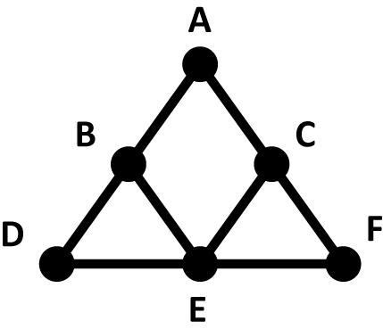
Another Example
Here is another graph that does not have an Euler circuit
Vertices B and C both have degree 3
If we want to “Eulerize” this graph, we have to duplicate edges that fix this problem

Slide 11
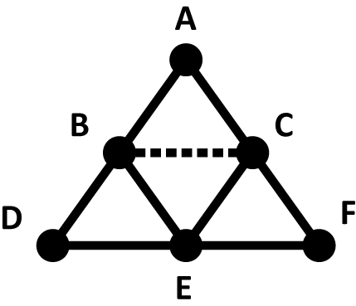
The Wrong Answer
You might be tempted to draw a new edge between B and C
This makes the degrees of B and C both equal to 4; the new graph has an Euler circuit

Slide 12
The Wrong Answer
The problem is that the Euler circuit we would find can’t be translated back to our original graph because in the original graph we can’t go directly from B to C
The mistake we made is that we didn’t duplicate an existing edge

Slide 13
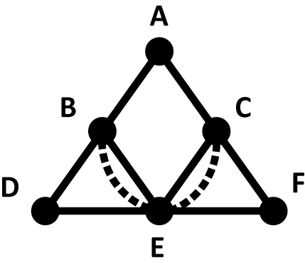
A Correct Answer
This time we duplicated two existing edges, and now all of the vertices have an even degree
We can find an Euler circuit for this modified graph, which gives us a circuit on the original graph that retraces itself twice

Slide 14
Minimizing Retraces
When we “Eulerize” a graph, every edge we duplicate represents an edge we’ll have to retrace on the original graph
The best possible solution to this type of problem would have the smallest number of duplicate edges possible
How do we know when we have found the best solution?

Slide 15
Guiding Principles
Duplicating an edge adds 1 to the degree of the two vertices it connects
Adding 1 to an odd number makes it even
So if we duplicate an edge that connects two odd vertices, that “fixes” both of them

Slide 16
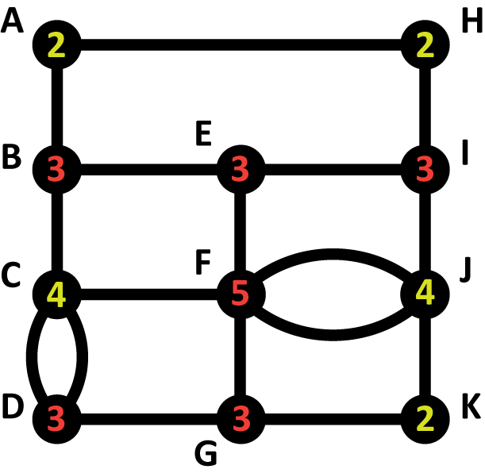
Another Example
In this example, there are six “bad” vertices that each have an odd degree
We might hope that we can “Eulerize” this graph using three new edges since each new edge could potentially “fix” two vertices each

Slide 17
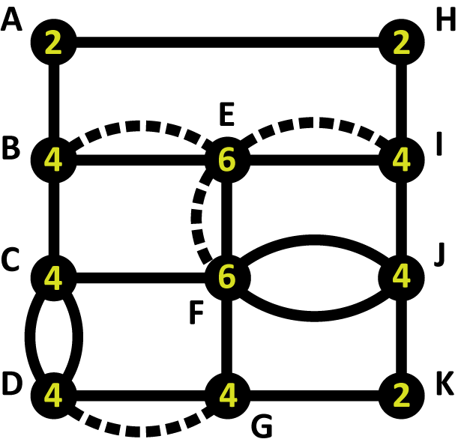
Another Example
However, it is not possible to “Eulerize” this graph using three edges
Here is one way to do it with four

